Slide 1

Support Vector Machines (SVMs)
by Yashas Tadikamalla,
Core, Epoch 21-22.

Slide 2
SVMs
Support Vector Machines (SVMs) are supervised machine learning algorithms that can solve classification and regression problems. It was originally developed by Cortes and Vapnik for classification (link to the original paper).
For this session, we will be focussing on the simplest variant, which is SVM to solve binary classification.

Slide 3
Few preliminary definitions
Hyperplane: Hyperplane is higher dimensional generalisation of a line in 2D space. It is used as a decision boundary to classify data.
Linearly separable data: Data is said to be linearly separable if there exists a hyperplane such that all the data belonging to a certain class lie on one side of the hyperplane.

Slide 4
Binary Classification problem
Given n-dimensional data, with two different classes, can we find a model that classifies the data?

Slide 5
Hard margin SVM
It tries to perfectly classify a set of points, by coming up with a hyperplane in the given dimensional space. It works only for linearly separable data.
If the data is linearly separable, then we have infinitely many hyperplanes (in the given dimensional space) that classifies all data points correctly.

Slide 6
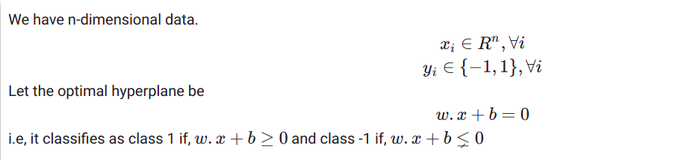
classifications. Hence, by maximising margin, we try to reduce low certainty classification decisions. Intuitively, it feels right. It also backed up by PAC theory.

Slide 7
The idea of SVM is to choose such a hyperplane that maximises the margin. Points near decision boundary represent uncertain classifications. Hence, by maximising margin, we try to reduce low certainty classification decisions. Intuitively, it feels right. It also backed up by PAC theory.

Slide 8
Some definitions
Margin: It is the distance of the closest point of the dataset from the hyperplane.
Support Vectors: The data points which influence the position and orientation of the optimal hyperplane.

Slide 9
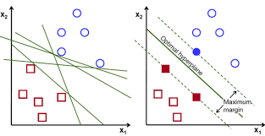

Slide 10
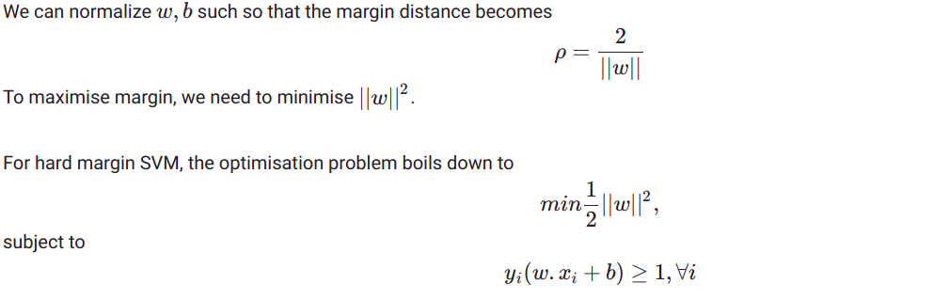

Slide 11
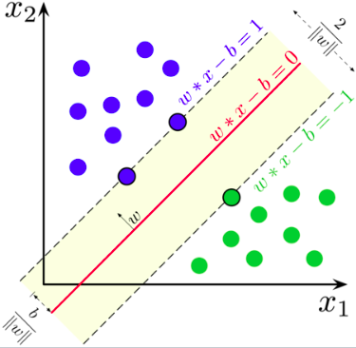

Slide 12
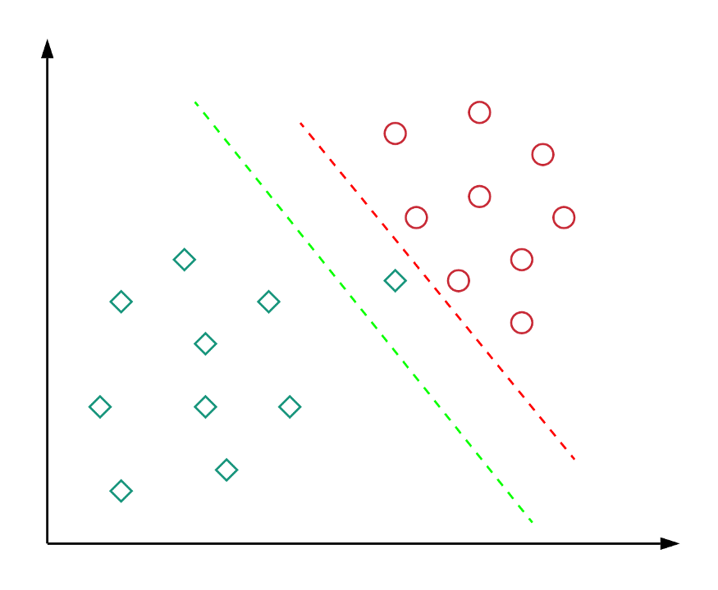
Hard margin SVMs fail to work well in cases like:
Though the red hyperplane classifies the data correctly, the green hyperplane has a wider margin, which makes it more generalised (ability to perform better on unseen data).

Slide 13
Most of the real-world problems have non-linearly separable data. Hence, hard margin SVM fail to produce a decision boundary. We overcome such problems by using a soft margin SVM. The idea is to allow some misclassifications and widen the margin, so that most of the points can be classified correctly. There is a tradeoff between maximising margin and minimising the misclassifications and we need to tune the hyperparameters to choose the best hyperplane.

Slide 14
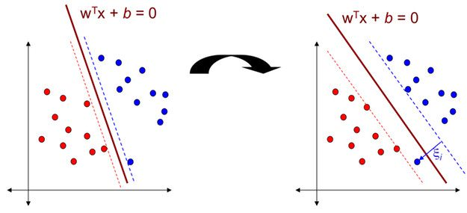
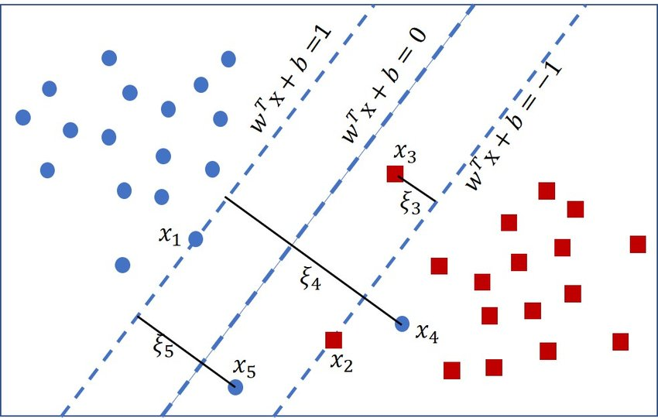
Soft margin SVM for better generalisation
Soft margin SVM for non-linearly separable
data

Slide 15
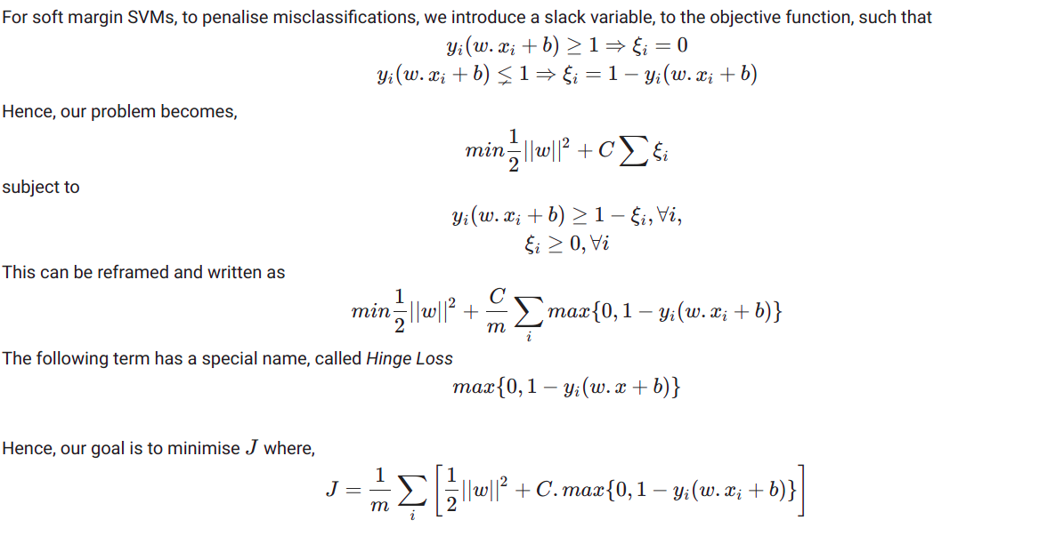

Slide 16
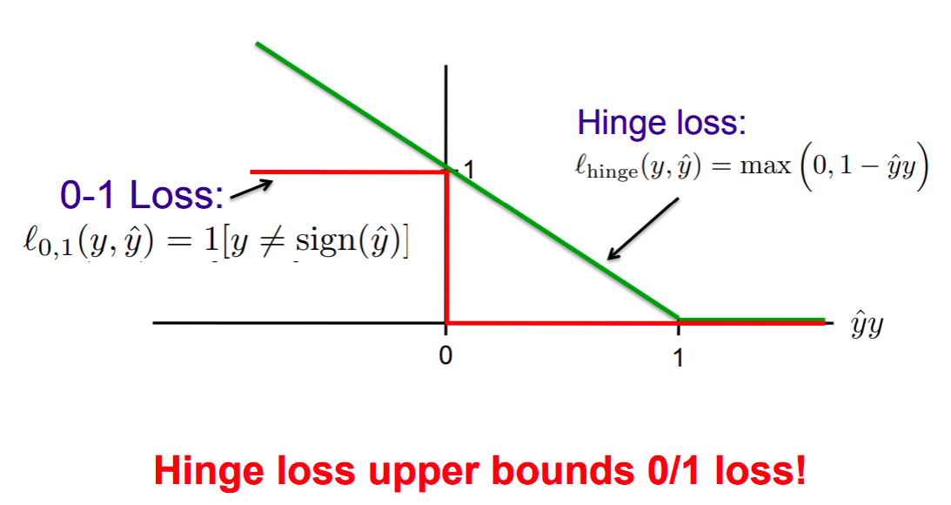

Slide 17
We can use this formulation in general for both linearly separable and inseparable data, and obtain a good classifier, by tuning the hyperparameters.
Large C implies priority is to minimise misclassifications.
Small C implies priority is to maximise margin.
The problem is now solved using gradient descent algorithm.

Slide 18
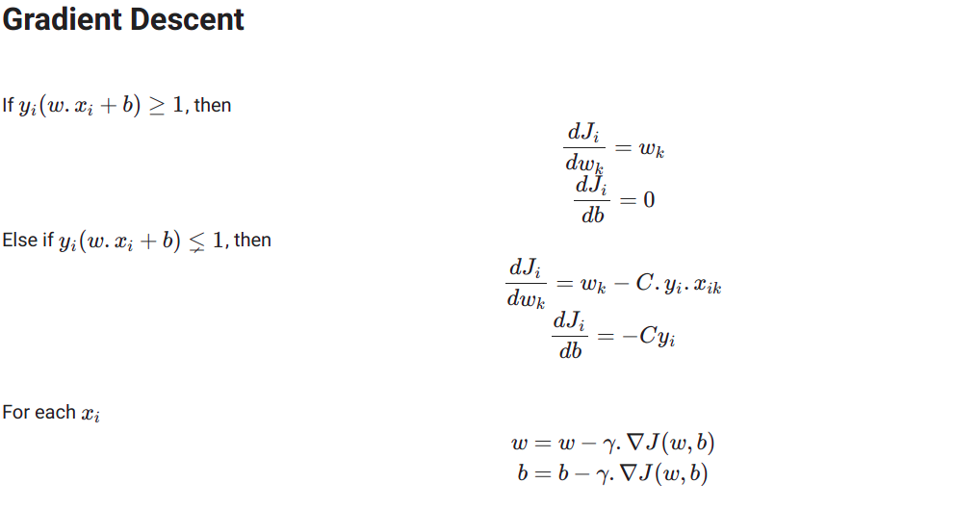

Slide 19

The problem of linear inseparability can also be tackled using Kernalisation. We can transform the data from input space to a new feature space using a basis function 𝜙(x).

Slide 20
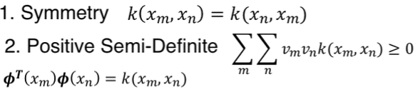
Kernel
A kernel is a symmetric and positive semidefinite function. i.e, it follows

Slide 21
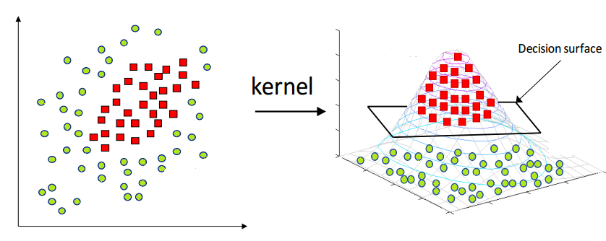

Slide 22
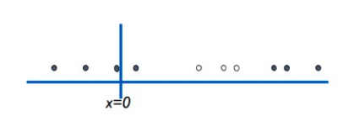
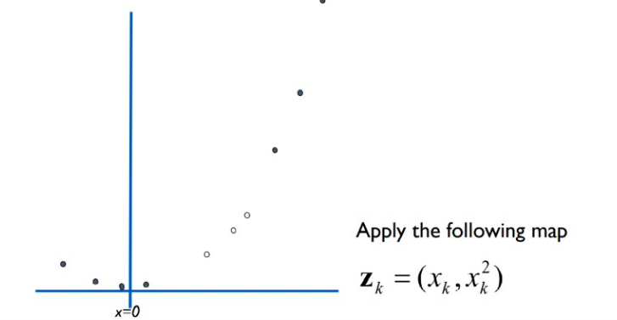

Slide 23
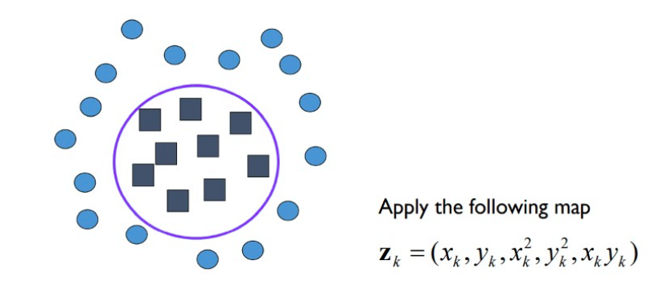

Slide 24
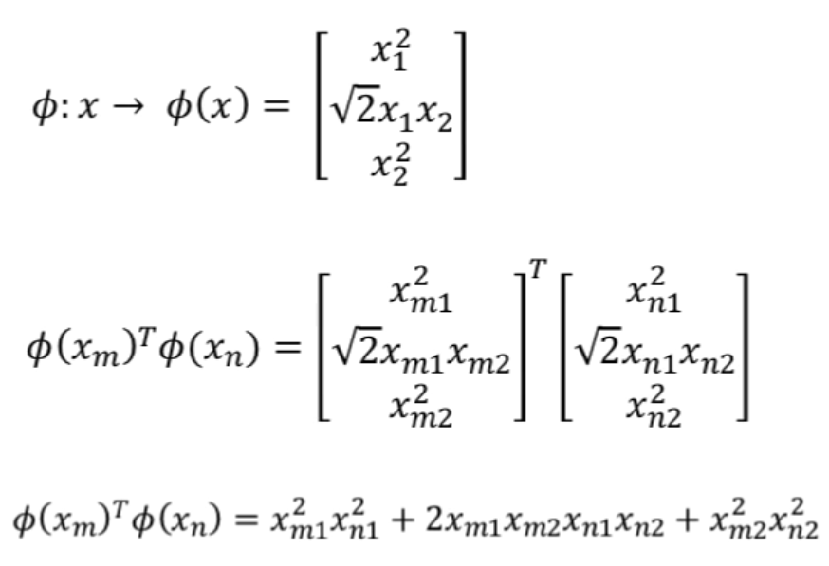
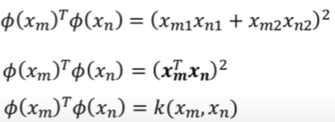

Slide 25
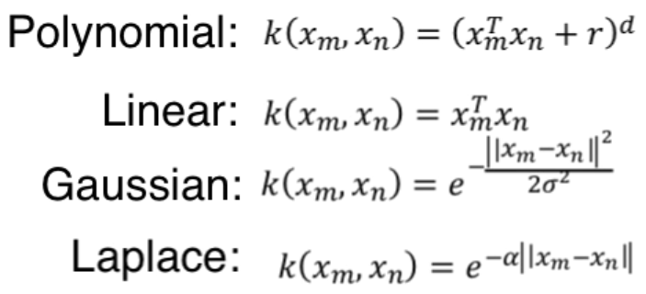
We can use the kernel functions, freely without any knowledge about 𝜙(x). Some kernel functions:

